Slide 1
Fitting Distributions to Your Data

Slide 2
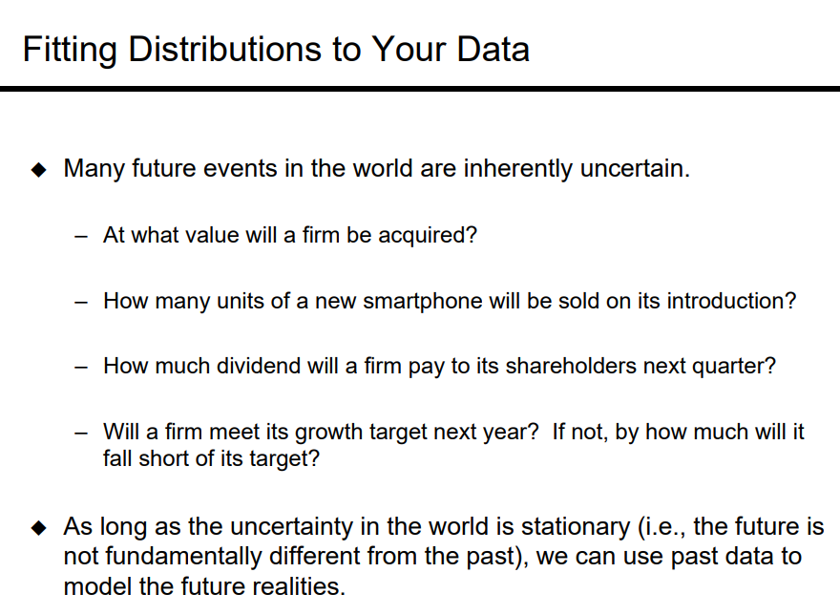

Slide 3
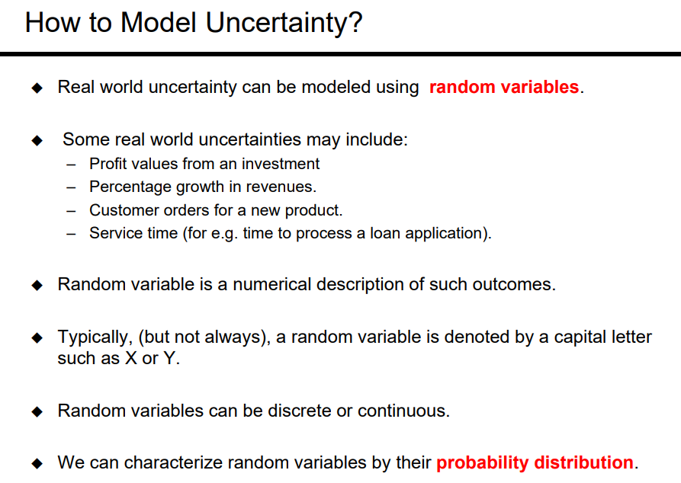

Slide 4
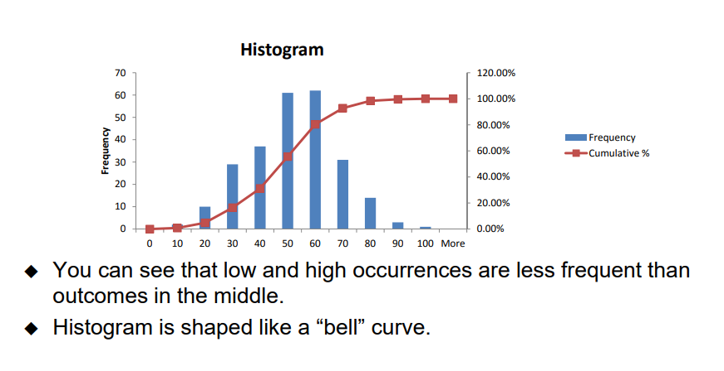
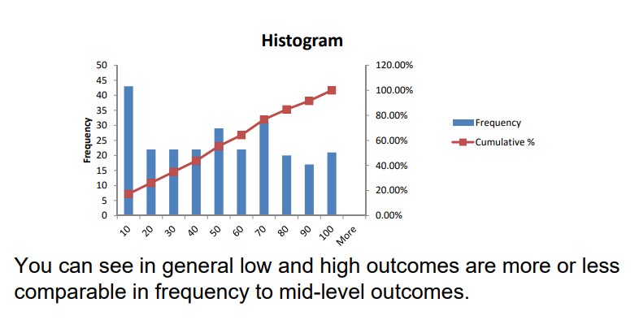
Distribution
By visualization, one could argue that the two datasets have two different distributions

Slide 5
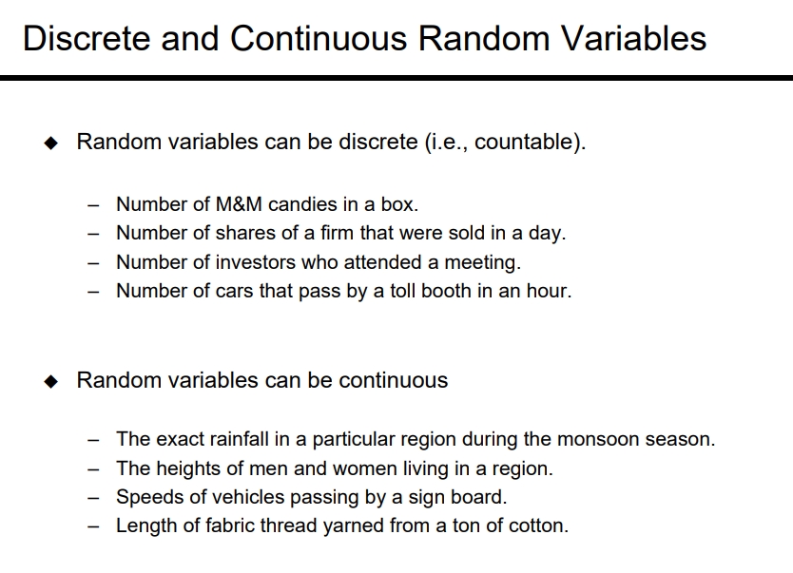

Slide 6
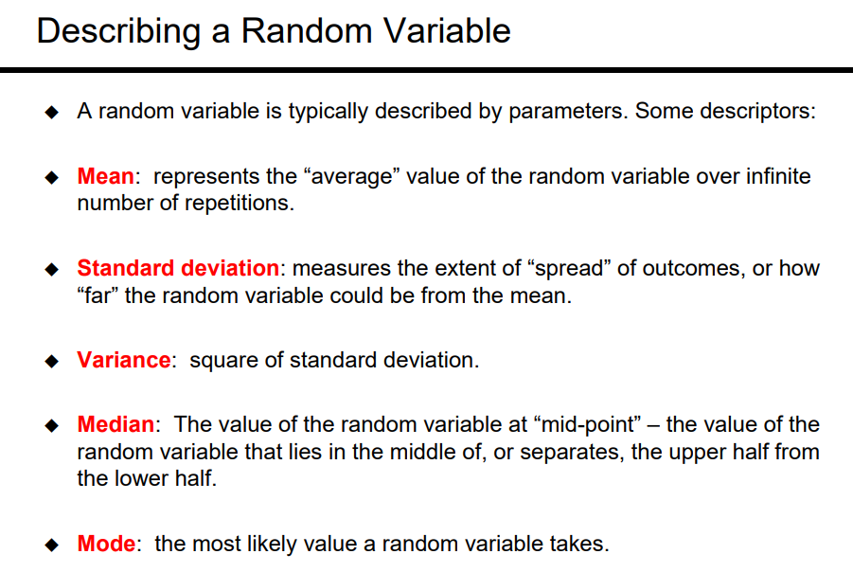
There are different type of distribution : Discrete and Continuous Distribution

Slide 7
Fitting distributions to data
We can make to fit a “right” distribution by visualizing the data
Goodness of fit tests provide statistical evidence to test hypotheses about the nature of distribution that can fit the data.
Two popular statistical goodness-of-fit tests are –
Chi-Square test
Kolmogorov-Smirnov test.
Anderson-Darling test is another test that is used less frequently.

Slide 8
Goodness of Fit
Definition: A chi-square goodness-of-fit test is used to test whether a frequency distribution obtained experimentally fits an “expected” frequency distribution that is based on the theoretical or previously known probability of each outcome.
An experiment is conducted in which a simple random sample is taken from a population, and each member of the population is grouped into exactly one of k categories.
Step 1: The observed frequencies are calculated for the sample.
Step 2: The expected frequencies are obtained from previous knowledge (or belief) or probability theory. In order to proceed to the next step, it is necessary that each expected frequency is at least 5.

Slide 9

Contd..
Step 3: A hypothesis test is performed:
(i) The null hypothesis H0: the population frequencies are equal to the expected frequencies.
(ii) The alternative hypothesis, Ha: the null hypothesis is false (what does this imply about the population frequencies?).
(iii) α is the level of significance. (A significance level of 0.05 indicates a 5% risk (95 % confidence interval) of concluding that a difference exists when there is no actual difference).
(iv) The degrees of freedom: k − 1.
(v) A test statistic is calculated using χ 2 value
(vi) From α and k − 1, a critical value is determined from the chi-square table.
(vii) Reject H0 if χ 2 is larger than the critical value (right-tailed test).

Slide 10
Question?
Example 1: Researchers have conducted a survey of 1600 coffee drinkers asking how much coffee they drink in order to confirm previous studies. Previous studies have indicated that 72% of Americans drink coffee. The results of previous studies (left) and the survey (right) are below. At α = 0.05, is there enough evidence to conclude that the distributions are the same?

Slide 11
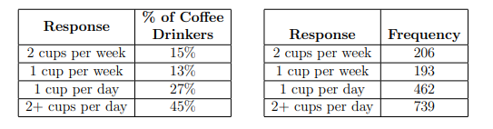
Data set
Previous study
Survey

Slide 12
Solution
(i) The null hypothesis H0:the population frequencies are equal to the expected frequencies (to be calculated below).
(ii) The alternative hypothesis, Ha: the null hypothesis is false.
(iii) α = 0.05.
(iv) The degrees of freedom: k − 1 = 4 − 1 = 3

Slide 13
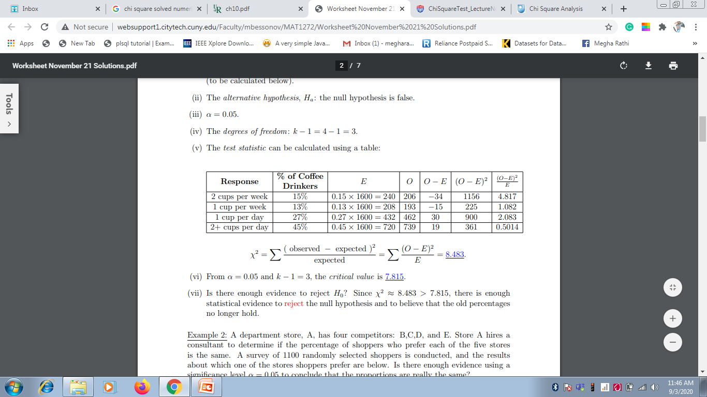
Solution

Slide 14
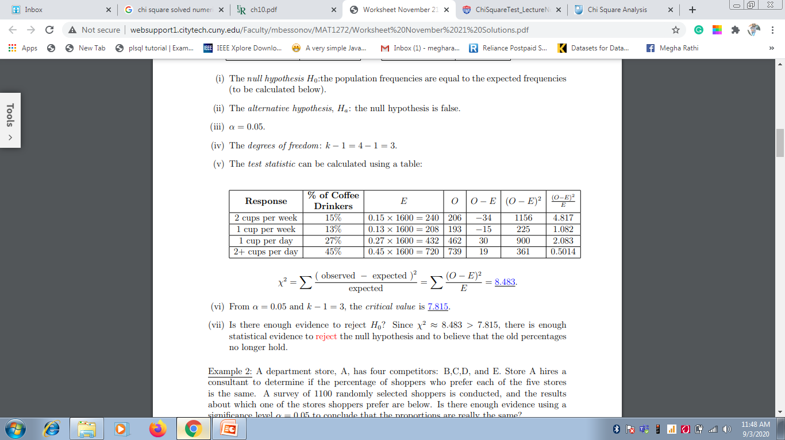
Solution

Slide 15
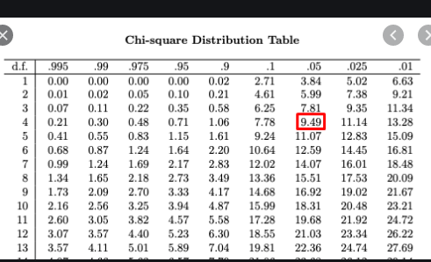
Chi Square Table

Slide 16
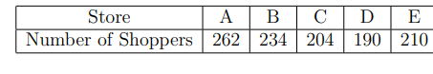
Numerical 1
A department store, A, has four competitors: B,C,D, and E. Store A hires a consultant to determine if the percentage of shoppers who prefer each of the five stores is the same. A survey of 1100 randomly selected shoppers is conducted, and the results about which one of the stores shoppers prefer are below. Is there enough evidence using a significance level α = 0.05 to conclude that the proportions are really the same?

Slide 17
Solution
(i) The null hypothesis H0:the population frequencies are equal to the expected frequencies (to be calculated below).
(ii) The alternative hypothesis, Ha: the null hypothesis is false.
(iii) α = 0.05.
(iv) The degrees of freedom: k − 1 = 5 − 1 = 4.
(v) The test statistic can be calculated using a table:

Slide 18
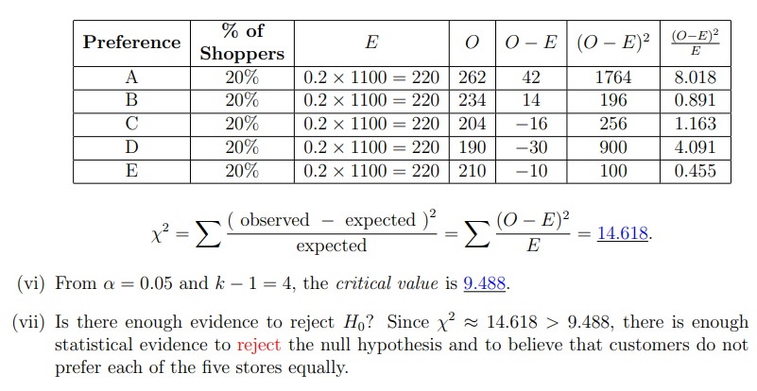
Contd..

Slide 19
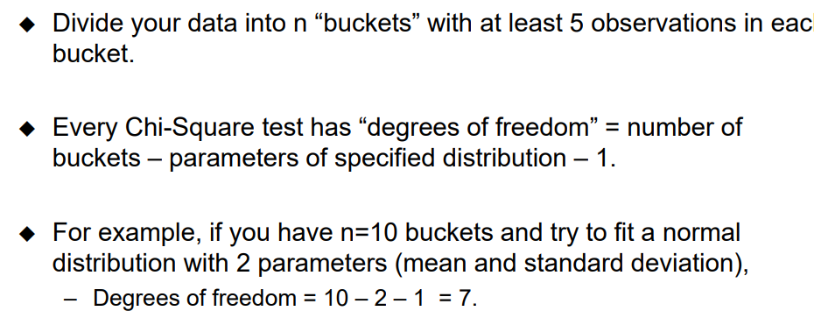
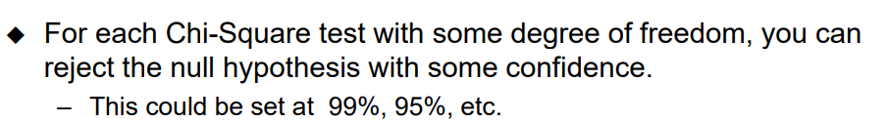
Running a Chi-Square Test on Data
Consider a dataset with 250 points distributed Normally

Slide 20
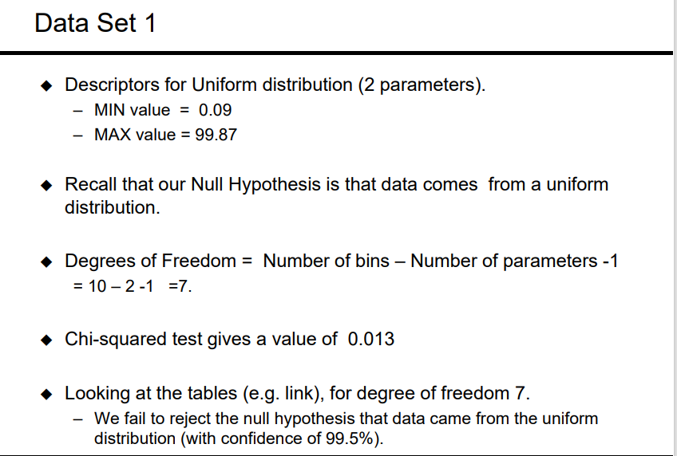

Slide 21
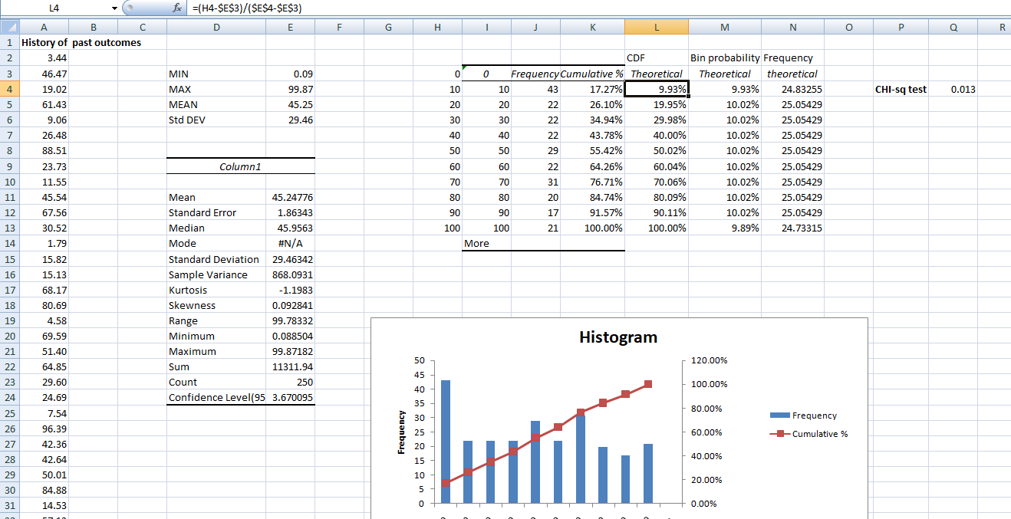

Slide 22
